Slide 1
School of Engineering
and
Information Technology
Project Risk Management

Slide 2
Learning Objectives
Understand what risk is and the importance of good project risk management
Discuss the elements involved in risk management planning and the contents of a risk management plan
List common sources of risks in information technology projects

Slide 3
Learning Objectives
Describe the process of identifying risks and be able to create a risk register
Discuss what is involved in monitoring and controlling risks
Describe how software can assist in project risk management

Slide 4
What is Risk?
A dictionary definition of risk is “the possibility of loss or injury”
A general definition of project risk is an uncertainty that can have a negative or positive effect on meeting project objectives
The goal of project risk management is to minimize potential negative risks while maximizing potential positive risks

Slide 5
Project Risk Management
Project risk management is the art and science of identifying, analyzing, and responding to risk throughout the life of a project and in the best interests of meeting project objectives

Slide 6
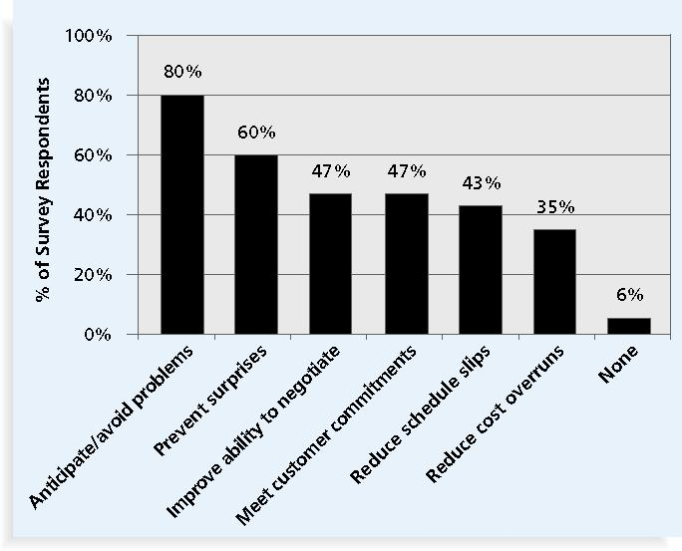
Benefits from Project Risk Management Practices*
*Kulik, Peter and Catherine Weber, “Software Risk Management Practices – 2001,” KLCI Research Group (August 2001).

Slide 7
Risk Can Be
Negative OR Positive
Negative risk involves understanding potential problems that might occur in the project and how they might impede project success
  Negative risk management is like a form of insurance; it is an investment
Positive risks are those that result in good things happening; sometimes called opportunities

Slide 8
Risk Utility
Risk utility or risk tolerance is the amount of satisfaction or pleasure received from a potential payoff
    Those who are risk-seeking have a higher tolerance for risk, and their satisfaction increases when more payoff is at stake
    The risk-neutral approach achieves a balance between risk and payoff

Slide 9
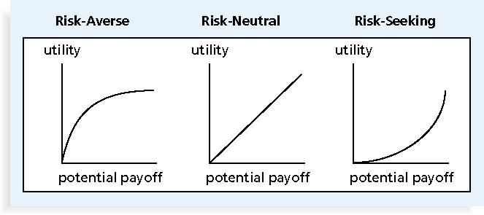
Risk Utility Function and Risk Preference

Slide 10
Assessment of Risk in Information Technology Projects
Several studies show that IT projects share some common sources of risk
The Standish Group developed an IT success potential scoring sheet based on potential risks
  Projects should not proceed if a minimum score is achieved

Slide 11
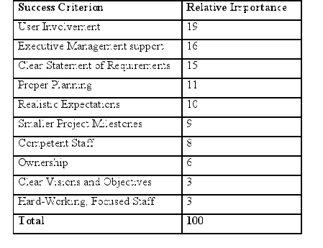
Information Technology Success Potential Scoring Sheet

Slide 12
Broad Categories of Risk
Market risk
Financial risk
Technology risk
People risk
Structure/process risk

Slide 13
What Went Wrong?
KPMG, a large consulting firm, published a
study in 1995 concerning runaway
projects—those that had significant cost
and/or schedule overruns—and found that::
55% did no risk management at all
38% did some (but half of these did not use their risk findings after the project was underway), and
7% did not know whether they did risk management or not

Slide 14
Project Risk Management Processes
Planning risk management: deciding how to approach and plan the risk management activities for the project
Identifying risks: determining which risks are likely to affect a project and documenting the characteristics of each
Performing qualitative risk analysis: prioritizing risks based on their probability and impact of occurrence

Slide 15
Project Risk Management Processes
Performing quantitative risk analysis: numerically estimating the effects of risks on project objectives
Planning risk responses: taking steps to enhance opportunities and reduce threats to meeting project objectives
Monitoring and controlling risks: monitoring identified and residual risks, identifying new risks, carrying out risk response plans, and evaluating the effectiveness of risk strategies throughout the life of the project

Slide 16
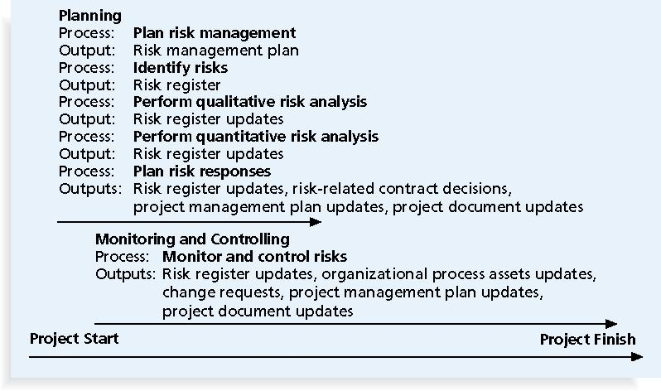
Project Risk Management Summary

Slide 17
1. Risk Management Planning
The main output of risk management planning is a risk management plan, which identifies and documents the procedures for managing risk throughout a project
The level of detail will vary with the needs of the project

Slide 18
Topics Addressed in a
Risk Management Plan
Methodology: how will risk management be performed?
Roles and responsibilities: who is responsible developing risk management
Budget and schedule: what are the costs of developing risk management?

Slide 19
Topics Addressed in a
Risk Management Plan
Risk categories: what are the risk categories?
Risk probability and impact: what is the likelihood and how will these be assessed?
Risk documentation: what are the reporting requirements for risk management?

Slide 20
Contingency and Fallback Plans
Contingency plans are predefined actions that the project team will take if an identified risk event occurs
Fallback plans are developed for risks that have a high impact on meeting project objectives and are put into effect if attempts to reduce the risk are not effective – basically if ‘all else fails’ this will be done

Slide 21
Risk Breakdown Structure
A risk breakdown structure is a hierarchy of potential risk categories for a project
Similar to a work breakdown structure but used to identify and categories risks

Slide 22
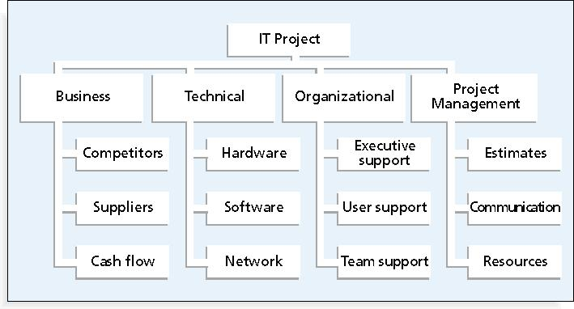
Sample Risk Breakdown Structure

Slide 23
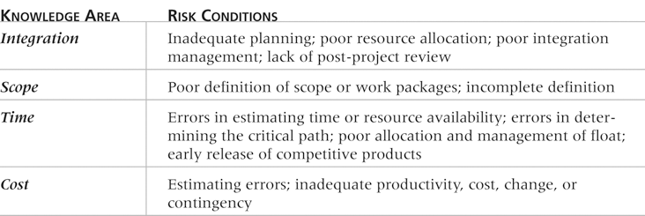
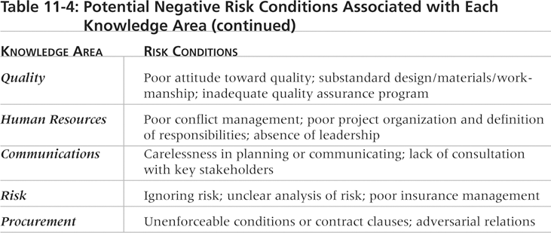
Potential Negative Risk Conditions Associated with Each Knowledge Area

Slide 24
2. Identifying Risks
Identifying risks is the process of understanding what potential events might hurt or enhance a particular project
Risk identification tools and techniques include:
    Brainstorming
    The Delphi Technique
    Interviewing
    SWOT analysis

Slide 25
Risk Register
The main output of the risk identification process is a list of identified risks and other information needed to begin creating a risk register
    A risk register is a document that contains the results of various risk management processes; often displayed in a table or spreadsheet format
    Risk events refer to specific, uncertain events that may occur to the detriment or enhancement of the project

Slide 26
Risk Register Contents
An identification number for each risk event
A rank for each risk event
The name of each risk event
A description of each risk event
The category under which each risk event falls
The root cause of each risk

Slide 27
Risk Register Contents
Triggers for each risk; triggers are indicators or symptoms of actual risk events
Potential responses to each risk
The risk owner or person who will own or take responsibility for each risk
The probability and impact of each risk occurring
The status of each risk

Slide 28
3. Performing Qualitative Risk Analysis
Assess the likelihood and impact of identified risks to determine their magnitude and priority
Risk quantification tools and techniques include:
    Probability/impact matrixes
    The Top Ten Risk Item Tracking

Slide 29
Probability/Impact Matrix
A probability/impact matrix or chart lists the relative probability of a risk occurring on one side of a matrix (or axis) on a chart, and the relative impact of the risk occurring on the other
It lists the risks (by ID number) and then allocates each one as high, medium, or low in terms of its probability of occurrence, and its impact if it did occur

Slide 30
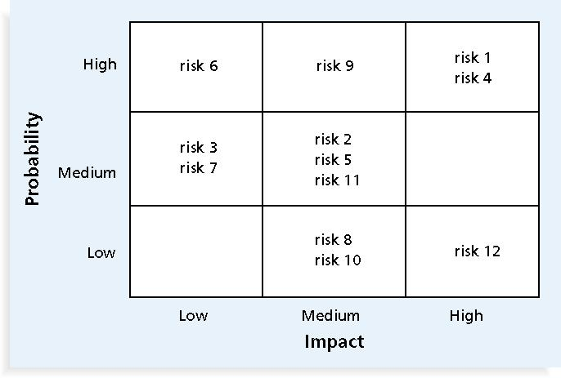
Sample Probability/Impact Matrix

Slide 31
Top Ten Risk Item Tracking
A qualitative risk analysis tool which helps identify and maintain awareness of risks throughout the project life cycle.
It involves establishing a periodic review of the most significant risk items and then monitoring and managing them
  Begins with a summary of the status of the top ten sources of project risk
  Monitors an item’s status from the current ranking, the previous ranking, number of times it appear on the list over a period of time, and a summary of risk resolution

Slide 32
4. Performing Quantitative Risk Analysis
Often follows qualitative risk analysis, but both can be done together
Large, complex projects involving leading edge technologies often require extensive quantitative risk analysis
Main techniques include:
    Decision tree analysis
    Simulation
    Sensitivity analysis

Slide 33
Decision Trees and Expected Monetary Value (EMV)
A decision tree is a diagramming analysis technique used to help select the best course of action in situations where future outcomes are uncertain
Estimated monetary value (EMV) is the product of a risk event probability and the risk event’s monetary value
  You can draw a decision tree to help find the EMV

Slide 34
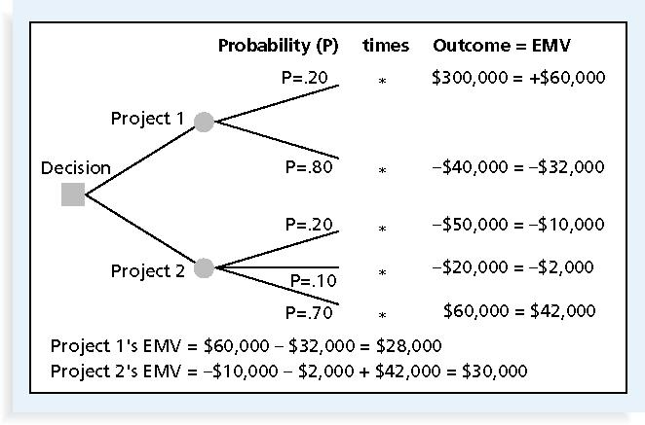
Expected Monetary Value (EMV) Example

Slide 35
Simulation
Simulation uses a representation or model of a system to analyze the expected behavior or performance of the system
Monte Carlo analysis simulates a model’s outcome many times to provide a statistical distribution of the calculated results
  To use a Monte Carlo simulation, you must have three estimates (most likely, pessimistic, and optimistic) plus an estimate of the likelihood of the estimate being between the most likely and optimistic values

Slide 36
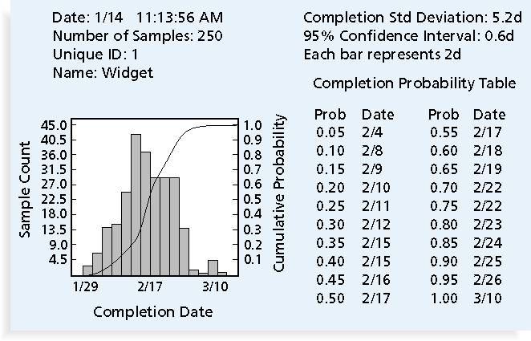
Sample Monte Carlo Simulation Results for Project Schedule

Slide 37
5. Risk Response Planning
After identifying and quantifying risks, you must decide how to respond to them
Four main response strategies for negative risks
    Risk avoidance
    Risk acceptance
    Risk transference
    Risk mitigation (reduction)

Slide 38
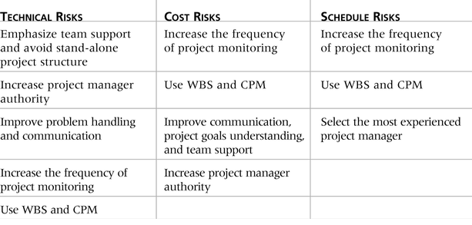
General Risk Mitigation Strategies for Technical, Cost, and Schedule Risks

Slide 39
6. Monitoring and Controlling Risks
Involves executing the risk management process to respond to risk events
Main outputs of risk monitoring and control are:
    Risk register updates
    Organizational process assets updates
    Change requests
    Updates to the project management plan and other project documents

Slide 40
Using Software to Assist in Project Risk Management
Risk registers can be created in a simple Word or Excel file or as part of a database
More sophisticated risk management software, such as Monte Carlo simulation tools, help in analyzing project risks
You can purchase add-ons for Excel and Project 2007 to perform simulations

Slide 41
Results of Good Project Risk Management
Unlike crisis management, good project risk management often goes unnoticed
Well run projects appear to be almost effortless, but a lot of work (including good project risk management) goes into running a project well
Project managers should strive to make their jobs look easy to reflect the results of well run projects

Slide 42
Topic Summary
Project risk management is the art and science of identifying, analyzing, and responding to risk throughout the life of a project and in the best interests of meeting project objectives
Main processes include:
    Plan risk management
    Identify risks
    Perform qualitative risk analysis
    Perform quantitative risk analysis
    Plan risk responses
    Monitor and control risks

